Slide 1


Slide 2
WHAT IS HAPPENING?
Starting in 2018, families can choose Cub Scouts for their sons AND daughters.
A Scouting program for older girls will be delivered in 2019, allowing participants to earn the highest rank of Eagle Scout.

Slide 3
HOW WILL IT WORK?
CUB SCOUTS
AGES 5-10 (OR GRADES K-5)
ALL-BOY CUB SCOUT PACK
BOYS & GIRLS CUB SCOUT PACK
ALL-GIRL CUB SCOUT PACK
CUB SCOUT PACK
ALL-BOY DEN
ALL-GIRL DEN

Slide 4
HOW WILL IT WORK?
Scouts BSA
February 2019
SEPARATE TROOPS FOR BOYS & GIRLS
AGES11-17 (OR GRADES 6-12)
LINKED TROOP
CHARTERED ORGANIZATION
CHARTERED ORGANIZATION
CHARTERED ORGANIZATION
TROOP COMMITTEE
TROOP COMMITTEE
TROOP COMMITTEE
ALL-GIRL TROOP
ALL-BOY TROOP

Slide 5
TIMELINE
MAR ‘18
APR ‘18
MAY ‘18
JUN ‘18
JUL ‘18
AUG ‘18
SEP ‘18
OCT ‘18
NOV ‘18
DEC ‘18
JAN ‘19
FEB ‘19
Early Adopter
K-4 Grades
(Jan-May 2018)
Cub Scouts Begin
Program Year 2018
Cub Scout Materials
In Scout Shops
(June 1, 2018)
Scheduled Launch of Program for Older Girls
Materials in Scout Shops for Program for Older Girls

Slide 6
Questions and Answers
Q. What program is available to girls who are older than Cub Scout age?
Scouts BSA, scheduled to launch in February 2019, will serve both boys and girls and offer the opportunity to earn the rank of Eagle Scout.
Q: What ages would be eligible for the program?
Mirroring the ages served by the existing Boy Scout program, Scouts BSA will serve girls who have completed the fifth grade and are at least 10 years old, or have earned the Arrow of Light and are at least 10 years old, or are age 11 but have not reached age 18.
Q. Will you change the program to accommodate girls?
Our existing programs are relevant for both boys and girls. After all, the values of Scouting as outlined in the Scout Law — trustworthy, loyal, helpful, friendly, courteous, kind, obedient, cheerful, thrifty, brave, clean, and reverent — are relevant and important values for both young men and women. As such, the program for girls ages 11 to 17 will be the same curriculum offered in the Scouts BSA program.
Q: Will the Scoutmaster position change in the program for girls?
No, the Scoutmaster is still responsible for training and guiding youth leaders in the operation of the troop and for managing, training, and supporting assistant Scoutmasters in their role.

Slide 7
Questions and Answers
Q: Can a boy troop and a girl troop share the same Scoutmaster?
A: No. Chartered organizations should have separate Scoutmasters for their boy troop and girl troop.
Q: Can both boy troops and girl troops share the same committee?
A: A chartered organization can decide if they want the same or separate committees.
Q: Can a boy troop and girl troop meet at the same time?
Yes. Based on the preferences of the chartered organization, the boy troop and girl troop could meet at the same time and place.

Slide 8
Questions and Answers
Q: If a chartered organization is not able to establish a new troop based on the required number of same-gender youth needed, can boy patrols and girl patrols be combined to form a troop?
No. A new troop must be started using the current youth and adult requirements; however, chartered organizations can consider the linked troop model so that the newly established girl troop will have the same COR and can share the troop committee.
Q: Can a boy troop and girl troop meet as one big troop?
Opening and closing of the meetings can be together or separate, depending on space and desire of the chartered organization and troop leadership. The other components of the Scout meeting should be run separately.
Q: Can boy and girl patrols make up a troop?
No. Troops must be all male or all female youth members.

Slide 9
Questions and Answers
Q: Can a boy troop and girl troop attend events together?
Yes, they can attend events together, as troops currently do.
Q: Can a boy troop and a girl troop plan events together?
No, the Patrol Leader’s Councils of each troop should be responsible for the planning of their perspective troop activities.
Q: Can a boy troop and girl troop coordinate outings together?
Yes, they can coordinate outings together if they are Scout-related following the Guide to Safe Scouting and Youth Protection guidelines.
Q: Can courts of honor be held jointly?
Yes, courts of honor can be held jointly if the chartered organization chooses.

Slide 10
Questions and Answers
Q: Can a council and district run camporees for boy troops and girl troops?
Yes, a council and district can run council and district events for both boy troops and girl troops if they are following the Guide to Safe Scouting and all current youth protection guidelines.
Q: Will chartered organizations be required to offer a program for girls?
Chartered organizations can decide which programs best serve the needs of their community, which means that the chartered organization can continue to offer Scouting for boys, or they may choose to add a unit for older girls.

Slide 11
Girls can do stuff

Slide 12
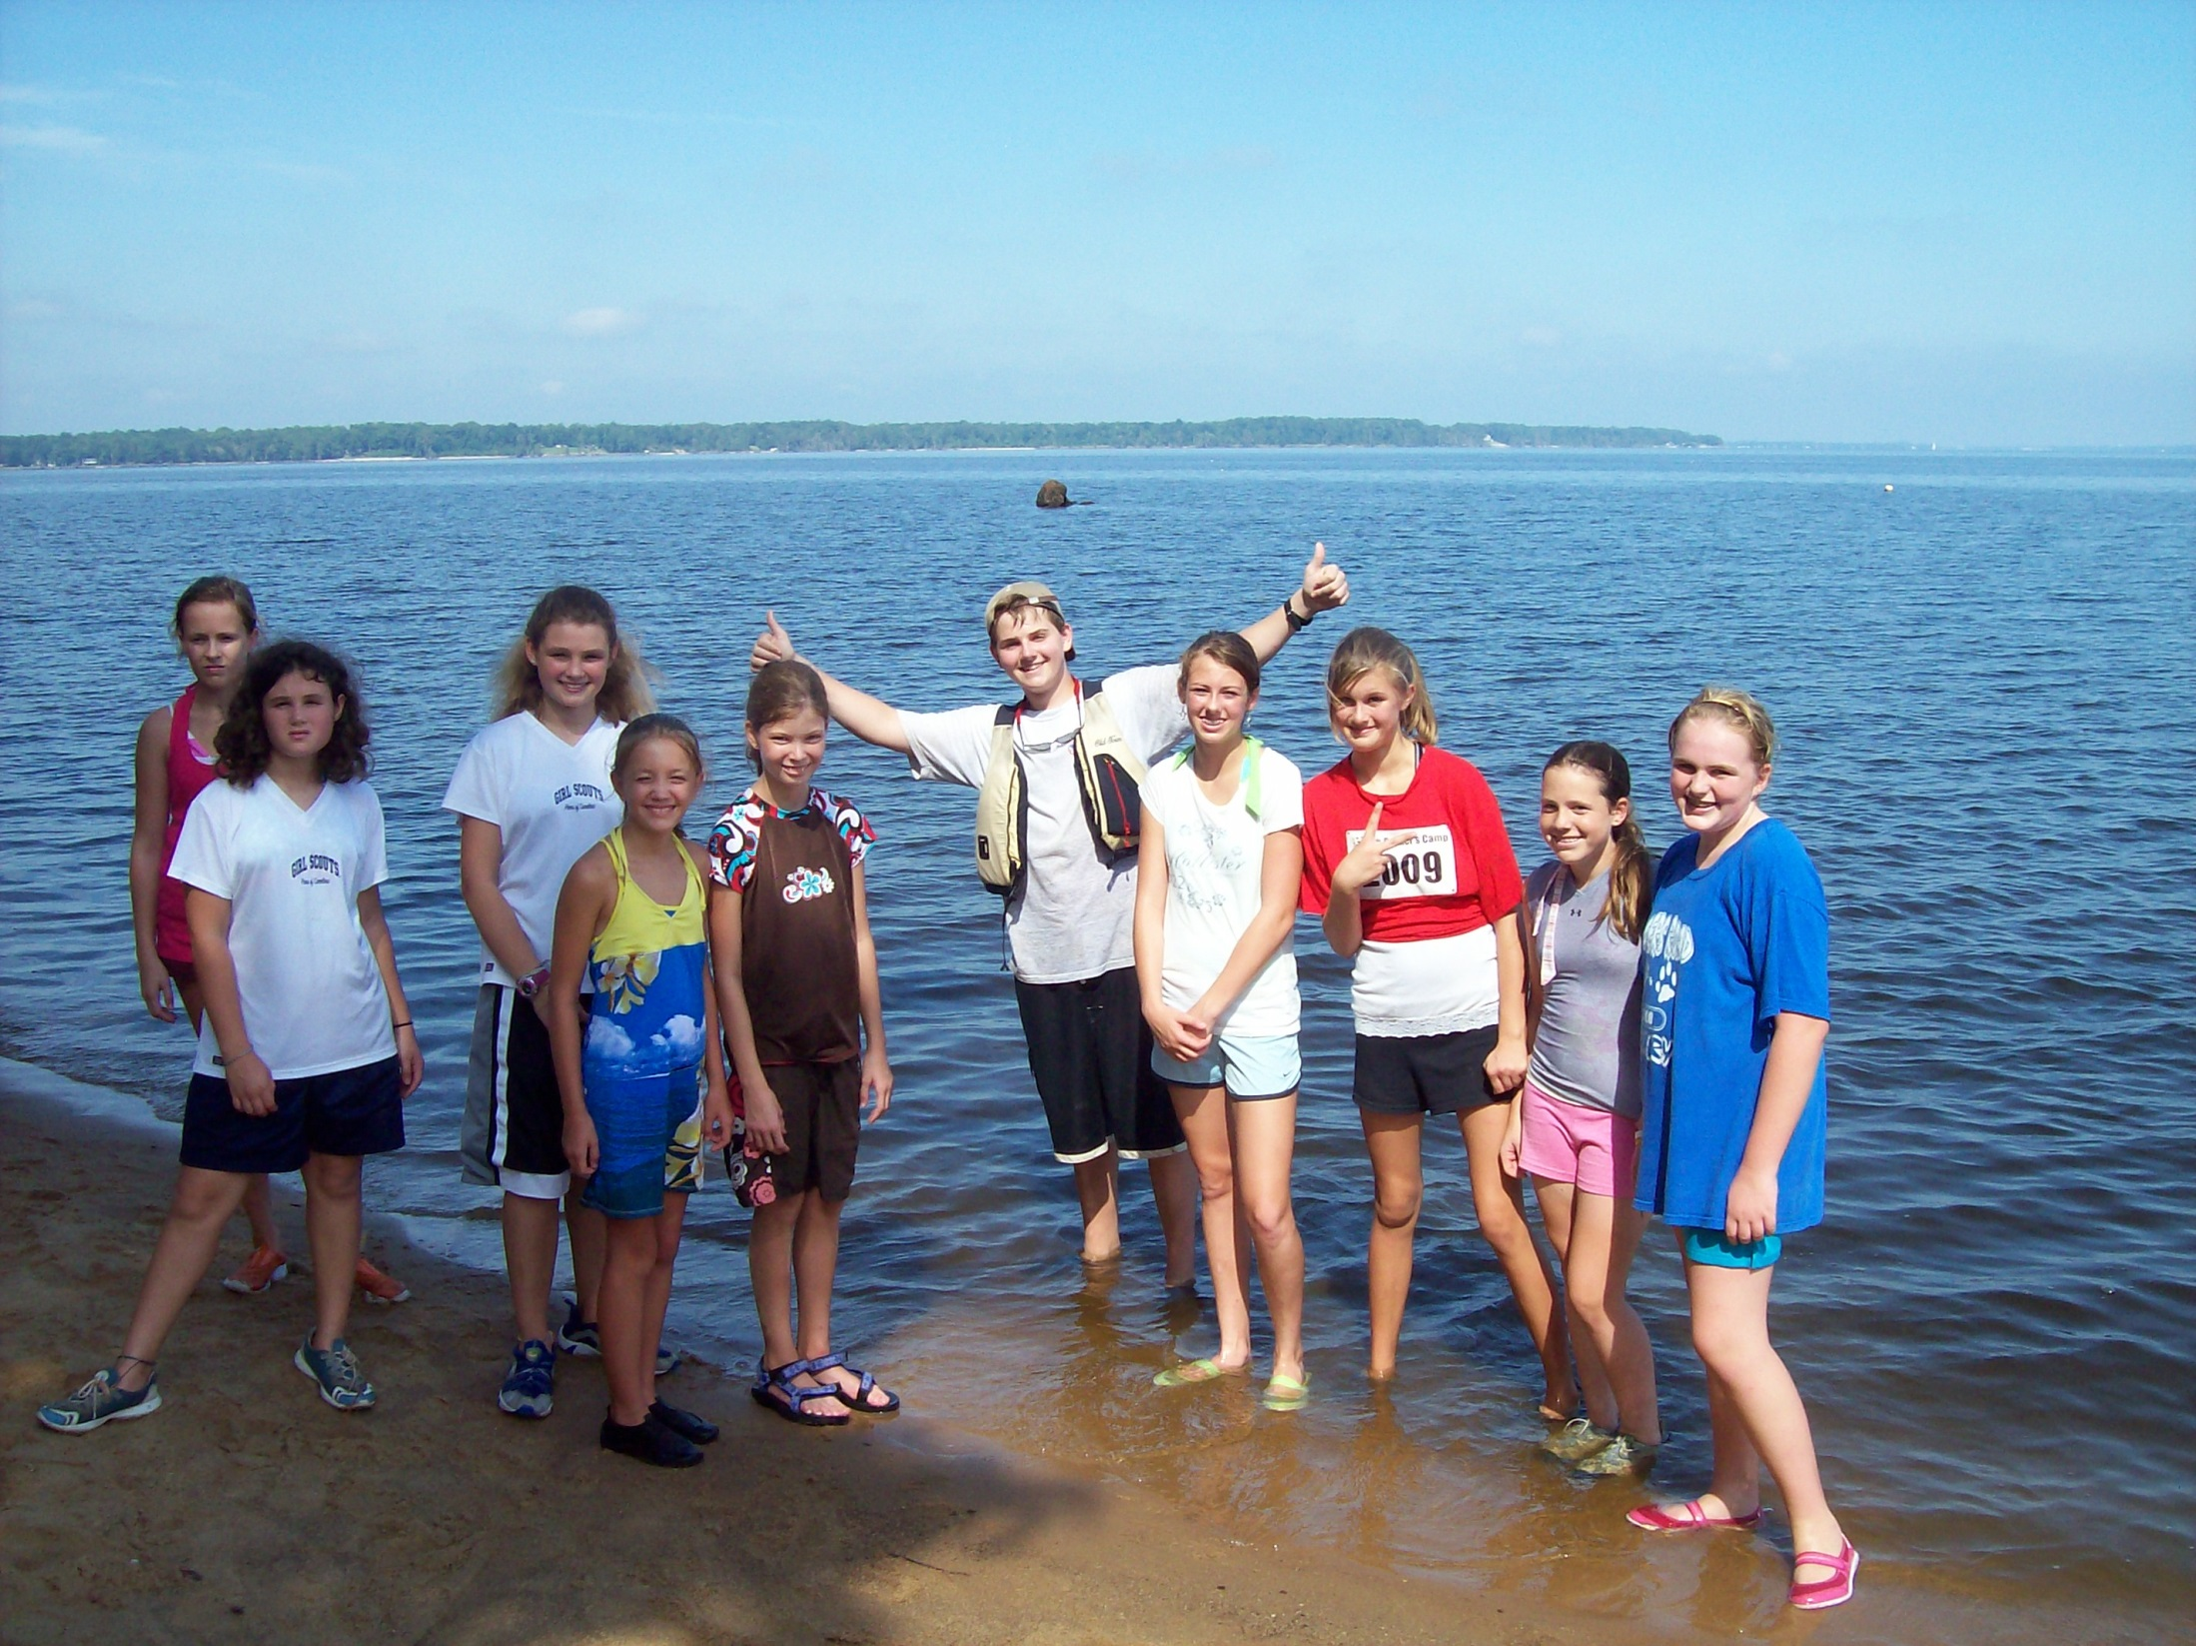
Pamlico Seabase 2009
Troop 214 Boy Scouts outdone by Girl Scouts

Slide 13
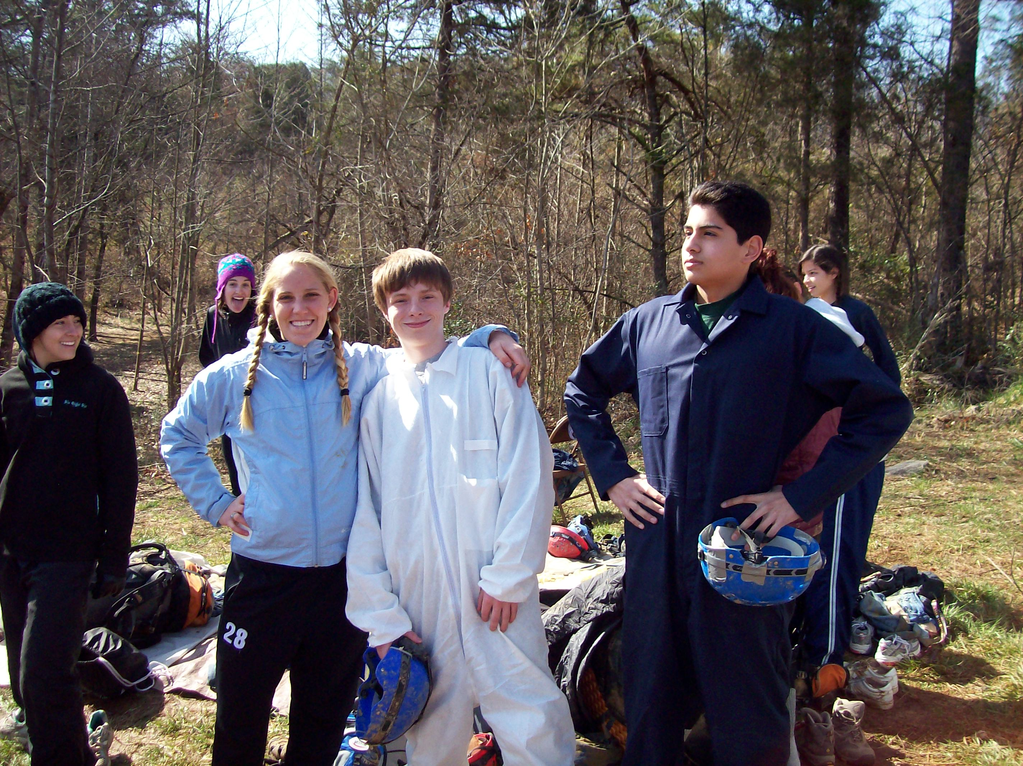
Caving in Tennessee 2010
Troop 214 Boy Scouts outdone by college girls

Slide 14
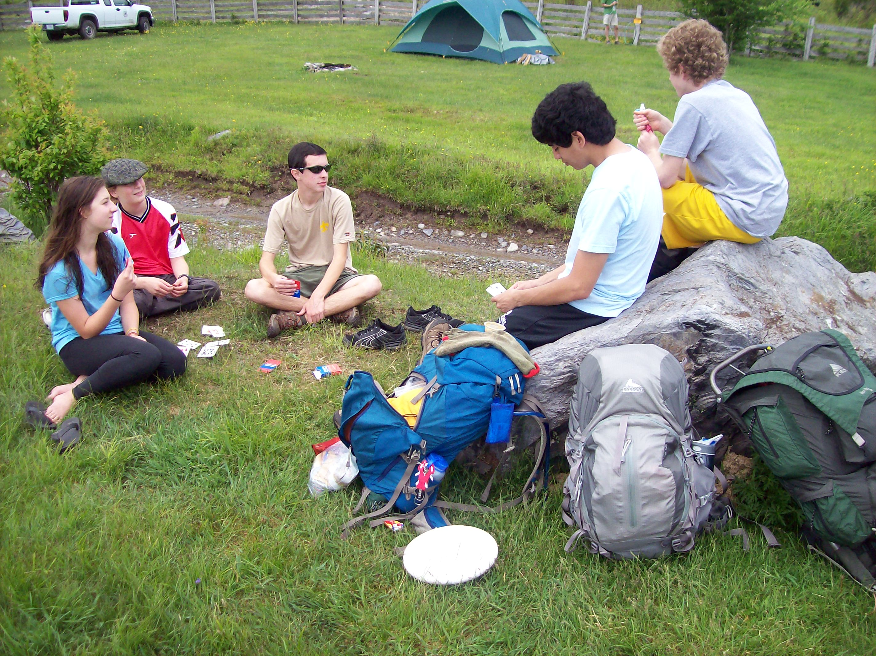
Grayson Highlands VA Backpacking 2011
Troop 214 Boy Scouts encounter home-schooled backpacking sisters

Slide 15



